Slide 1



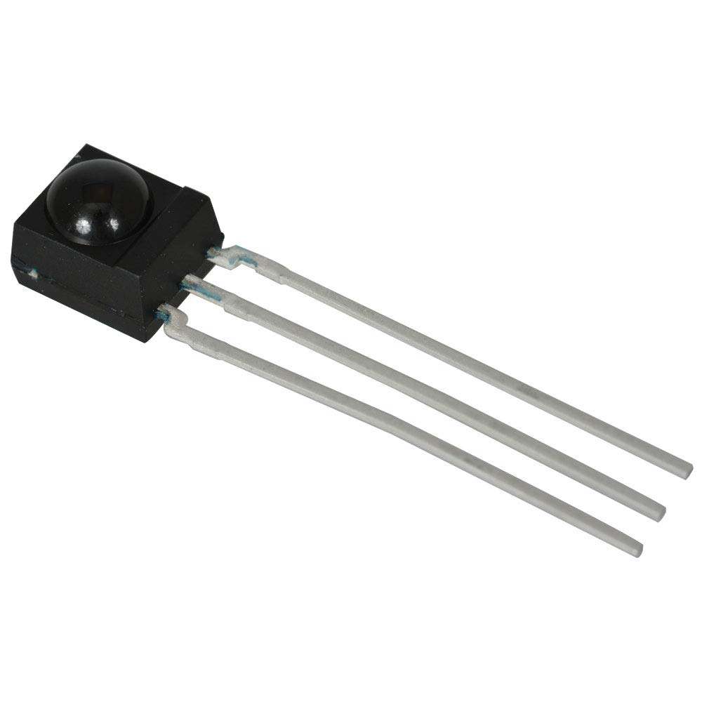
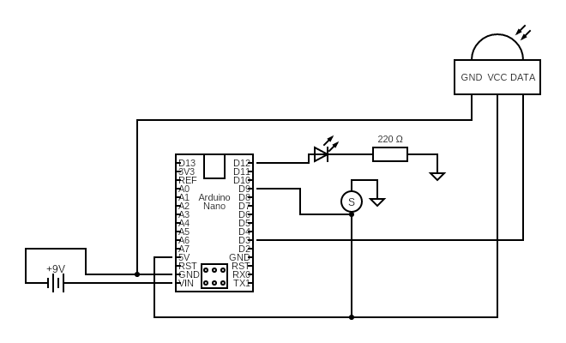
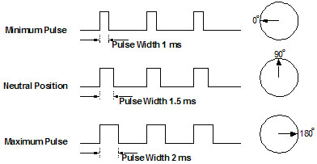
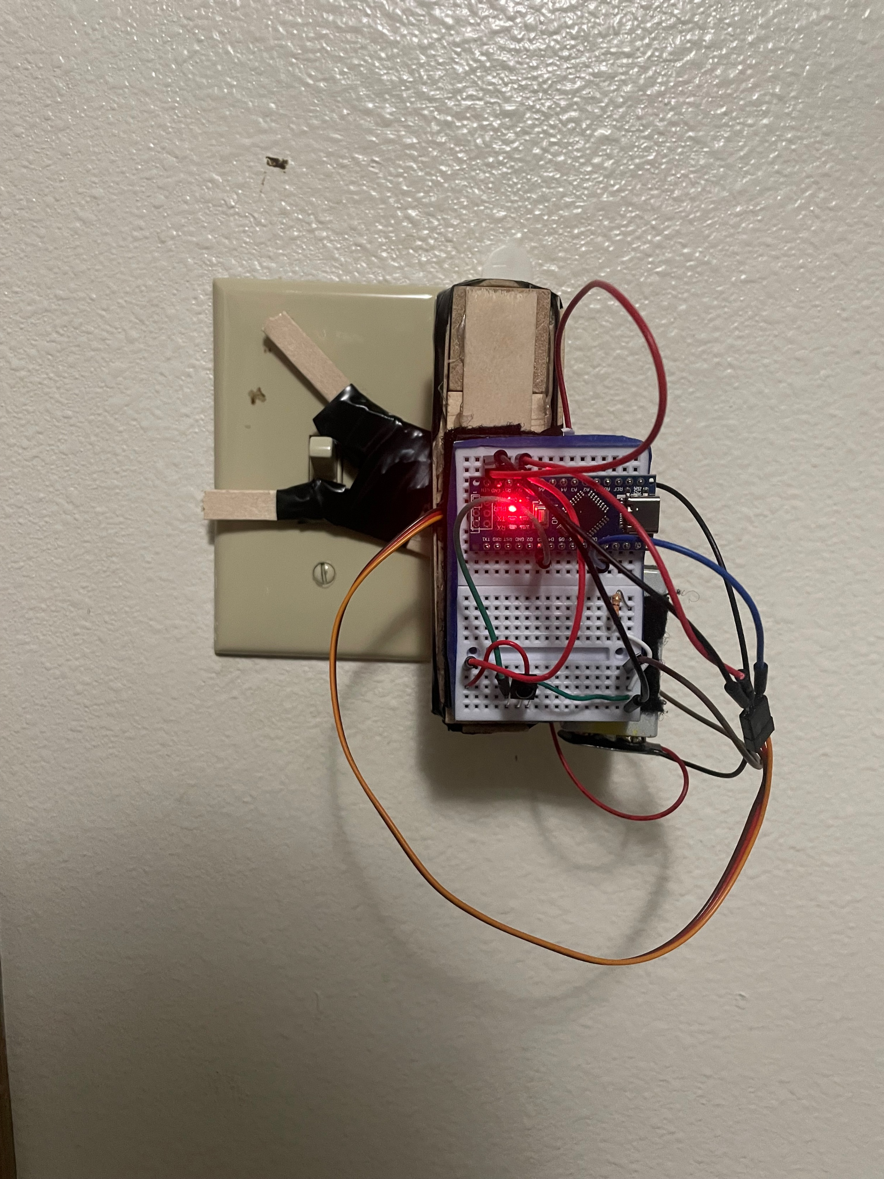
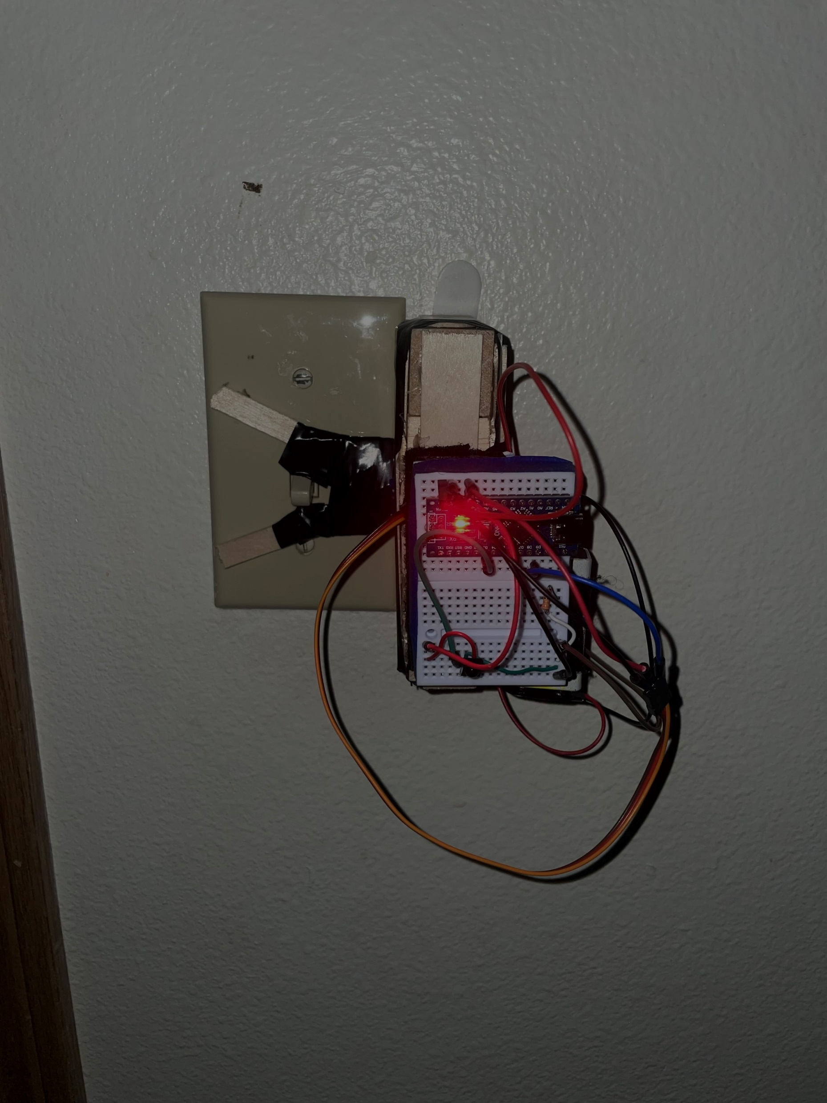
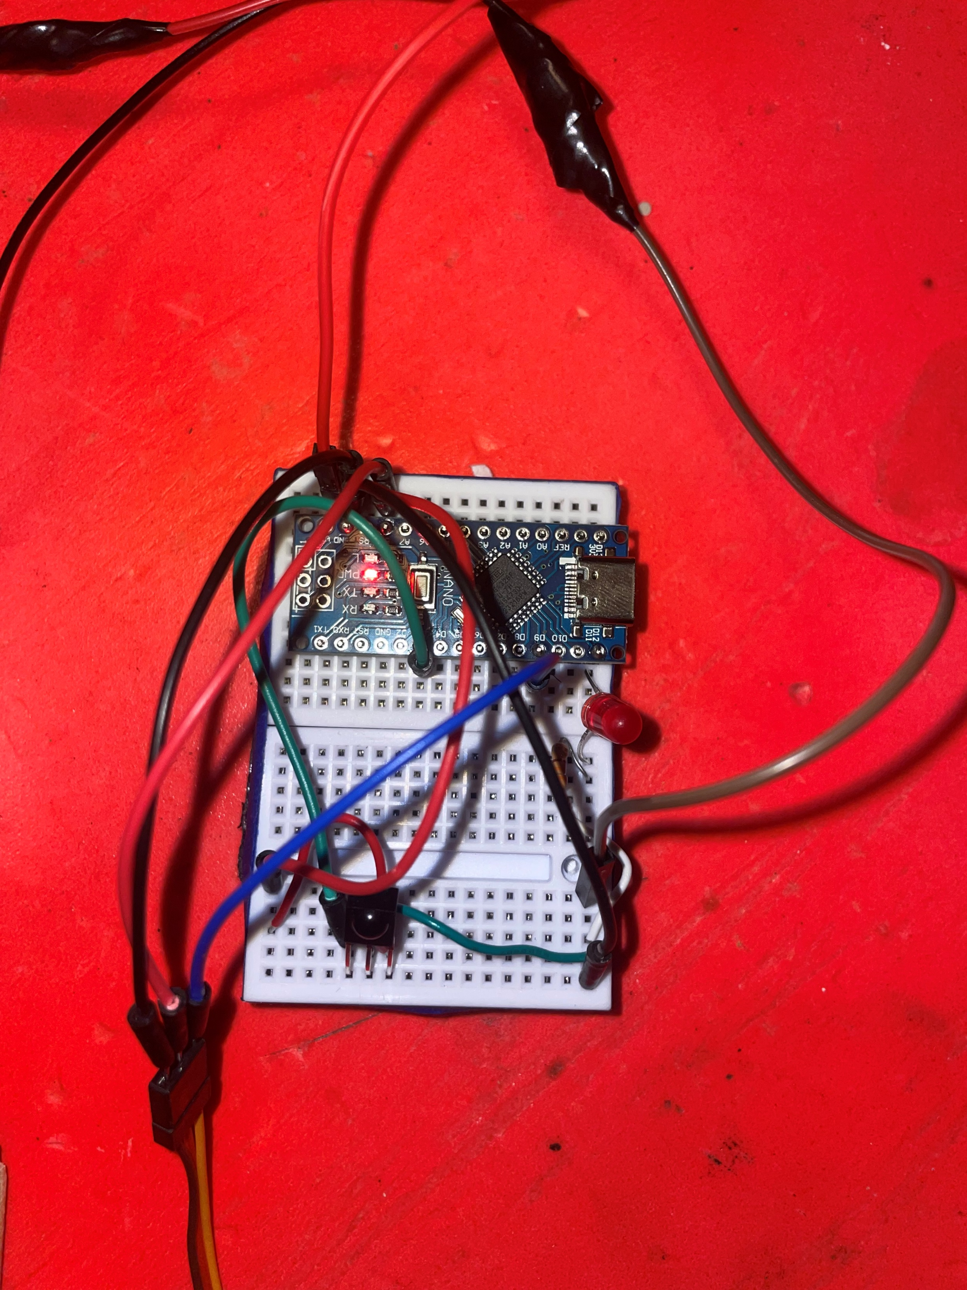
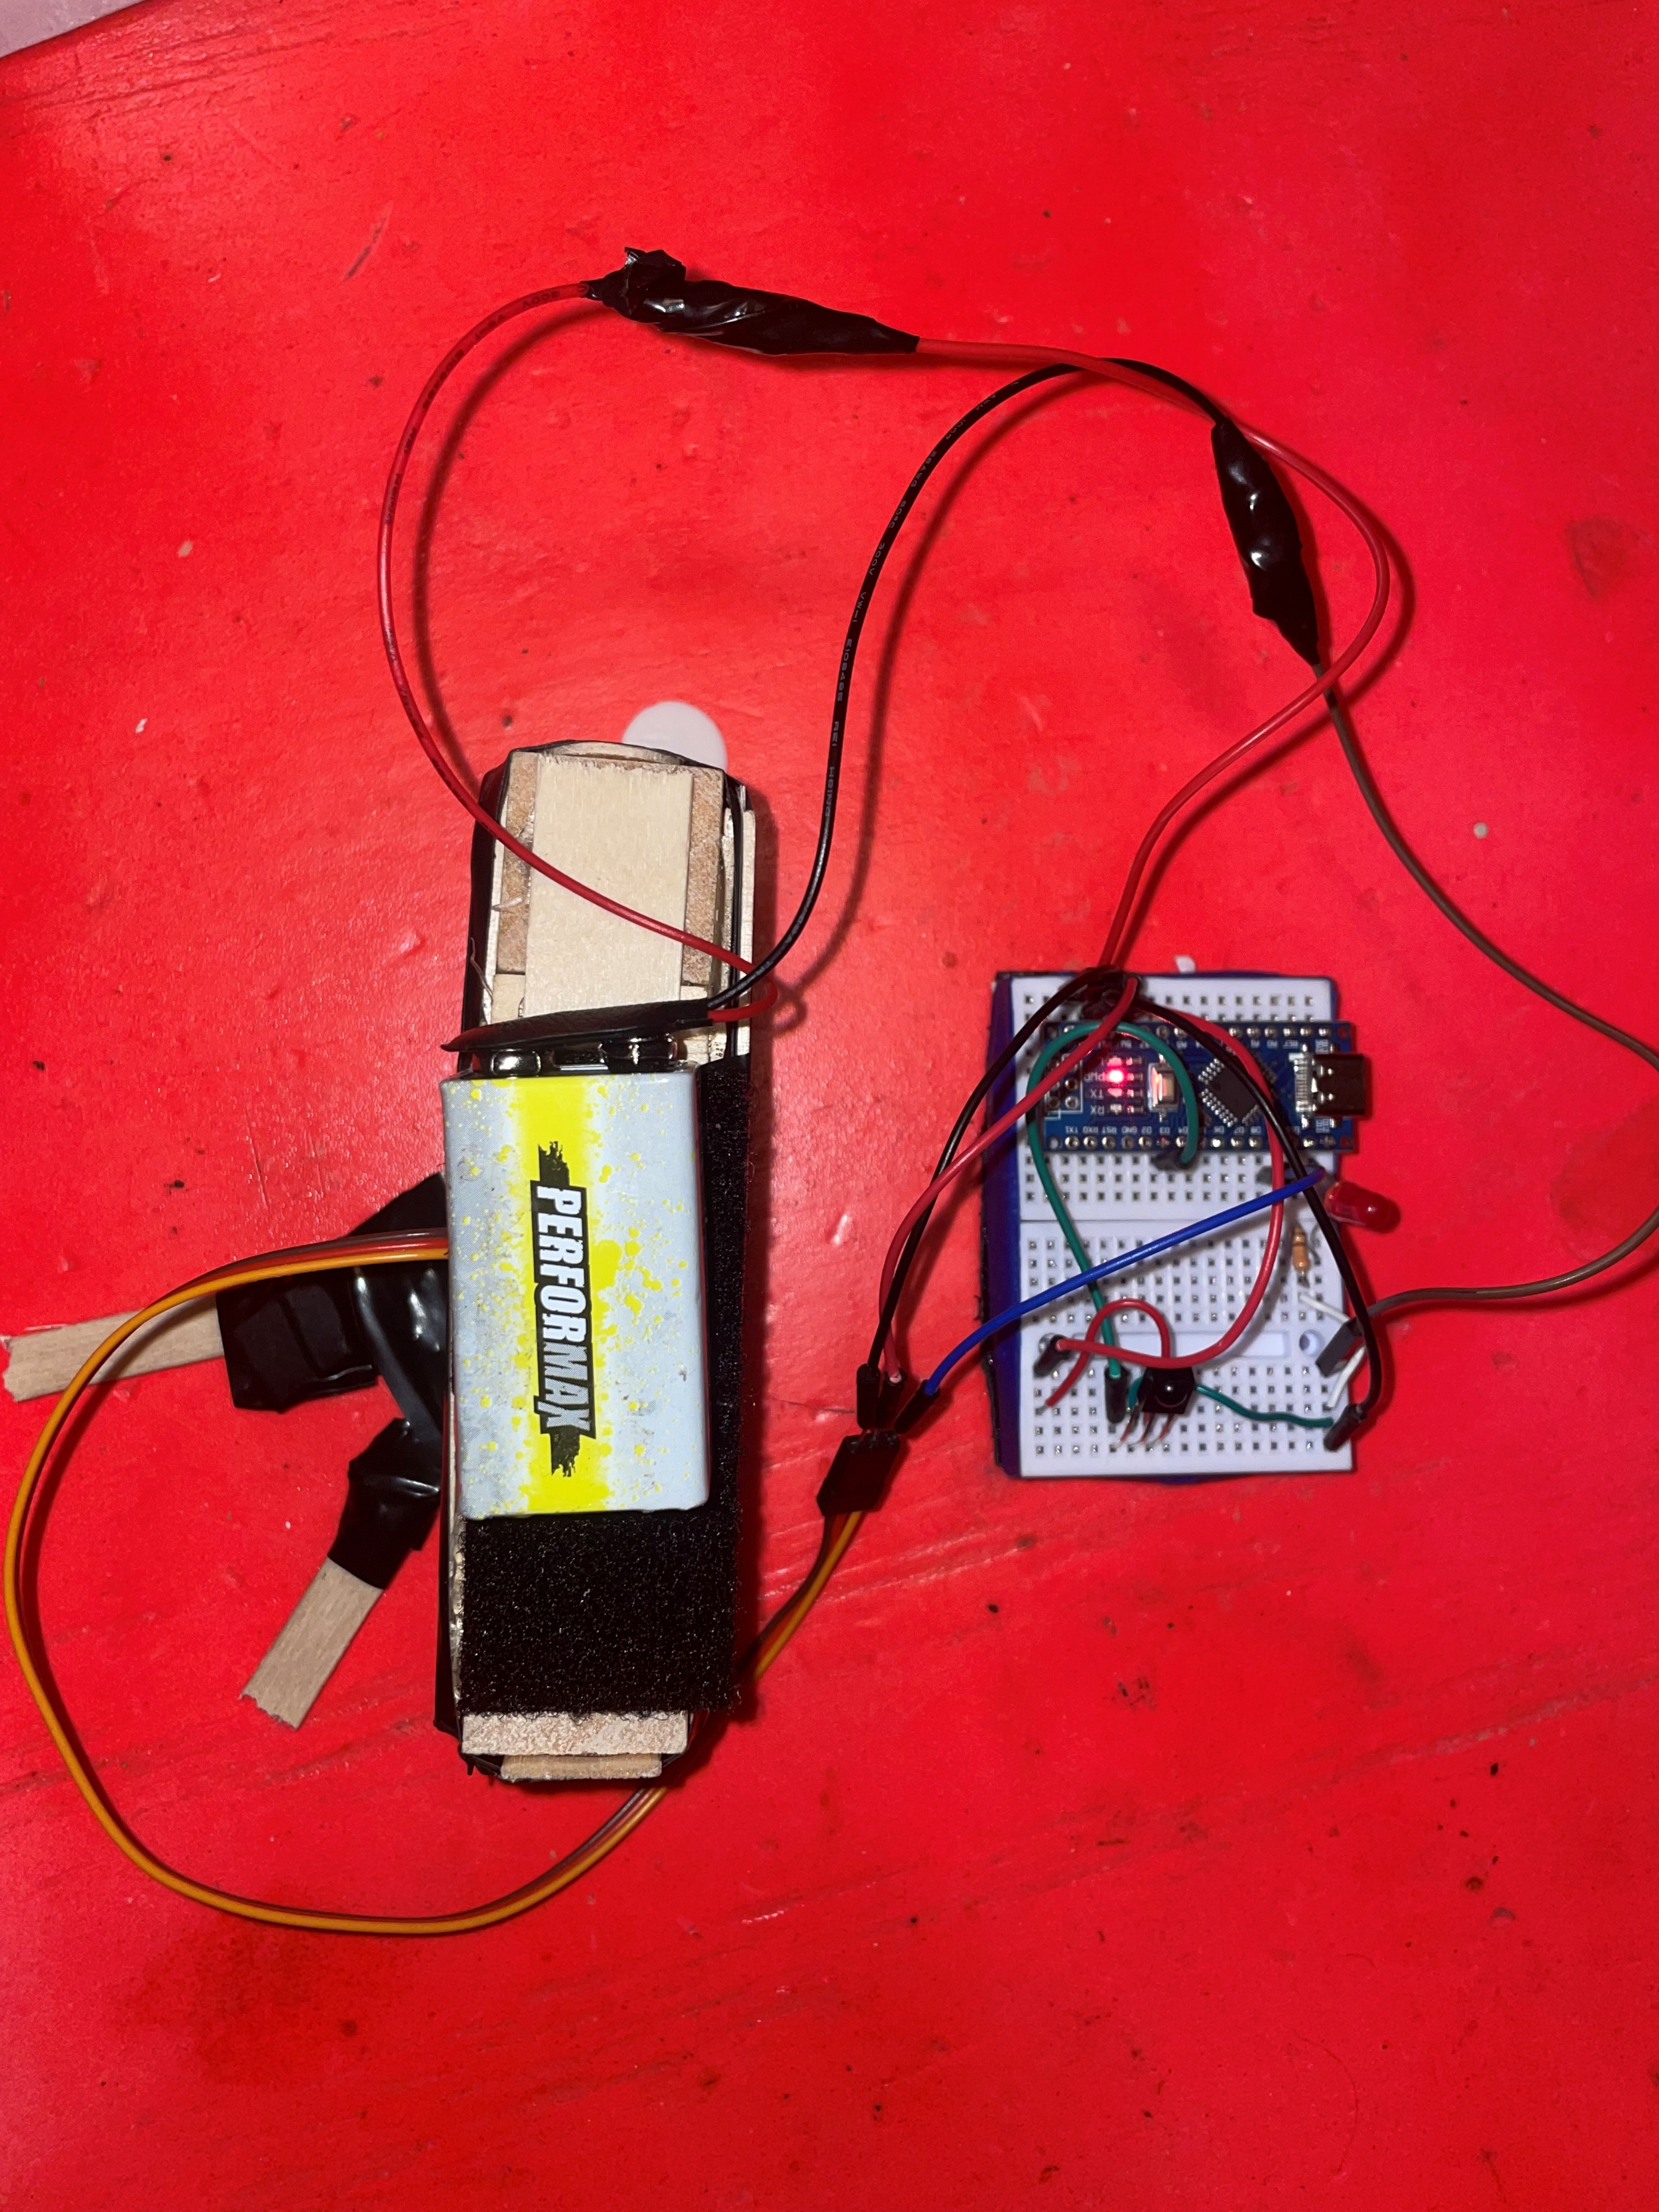
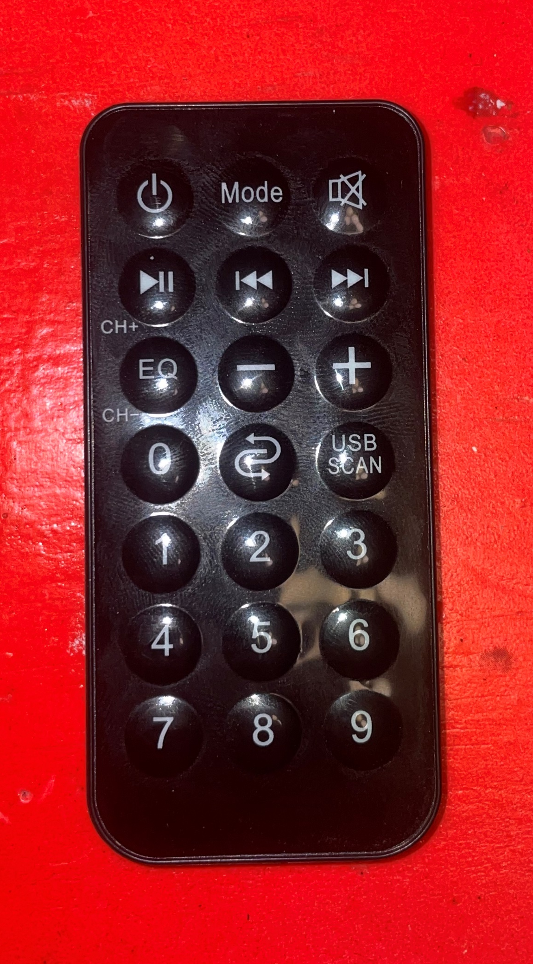
Remote Control Light Switch
Dawson Crowley, Zak Mineiko
Abstract
This project is a light switch that uses an IR sensor (Rx) and remote control (Tx) to actuate a micro servo motor. Attached to the motor is a housing and spinning arm that controls the light switch. The main hardware is attached to a breadboard that sticks to the housing via Command Strips. We are using an Arduino Nano Microcontroller with an ATMega328p microprocessor to control input as well as the servo motor operations. There is also a red LED that indicates when the button on the remote is pressed. The light switch can be activated from anywhere in a room with any remote within a range of 20 feet.
Introduction
Motivation
The product was initially created to provide a simple system that takes little effort to control the lights of a house. We wanted something robust, easy to use and user friendly for everyone. Most homes have at least one remote in them so this system would be an easy to implement.
Background
We tested out a few sensors to see if we could implement a way to pick up infrared pulses from the iPhone however had no success. We settled with the KSOP4838 which operates at around 38 kHz which is plenty to accommodate for various remotes. It also has good immunity to common household noise (lamps, LCD TV, Wi-Fi). Most remotes will work with this system.
System Description
The major components within our system are shown here:
The Arduino Nano microcontroller (ATMega328p) – programs the servo motor
SG90 servo motor – toggles light switch
9 Volt battery – for powering Arduino
KSOP4838 IR sensor – receives IR signal of 38 kHz
Remote control – Transmitter for the IR sensor
Red Led – indicates when IR signal received
Control arm and mount – houses the breadboard with all electrical components and the 9-volt battery
Circuit diagram drawn with circuit-diagram.org
PWM to control servo motor to control the positioning of light switch arms
Results
Individual Components
Lessons Learned
Light is on, servo before actuation
Servo actuated, light off
One of the most challenging parts of this project was finding the correct sensor to fulfill our original goal of making an iPhone activated light switch. Trial and error lead us down an alternate path as we learned a bit more about how datasheets describe IR sensors. Another big hurdle was getting the correct timing down for pulse width modulation with the servo motor in the C code. We also struggled with the mechanism that turns the light off since we did not have access to a working 3D printer.
Conclusion
Overall, this project taught us a great deal about correctly measuring and gauging the specifications for fulfilling a goal of a project. Despite not fulfilling our original goal, we still saw success with the remote route. This project birthed a reliable, simple, and easy to use embedded system.
References:
Gupta, K. (2020, December 27). Servo Motor Embedded C code: Using Timers, PWM OF AVR MCU(ATMEGA2560/328P, Arduino Mega/Uno/nano). YouTube. https://www.youtube.com/watch?v=Ix2LylgegnA
ECE:3360:0001 Embedded Systems 2024
The University of Iowa

